Slide 1
Effective Missing Data Prediction for Collaborative Filtering
Karan Pradhan
S3814520:

Slide 2

A brief information of solution from the report:
1: Start by Calculating the PCC as usual but in this case for both user and item.
2:Calculate significance weight for both user and item.
3:The main idea starts here:
Find similar users and similar items but now we bound them with a threshold ITA for user and THETA for items.(First step to tackle the drawback of K-Top Neighbours)
Similar user and items-> basically are all set of similar item and user.
Unlike K-Top Neighbours where we look over only K number of neighbours.(inaccurate approach).
Following by where we do the effective data prediction. By Meeting some conditions as explained in slides to come.

Slide 3
Approaches discussed in the Report:
From the given report we get to know the Two main approach for Collaborative filtering approach:
Memory based approach:
If we look at the memory based approach we get to know that it has two approach Item based and the user based approach.
Here simple user based approach we try to find rating of active user considering the rating of similar users and similarly for item based we predict by overviewing the similar item the active user has enumerated.
Here both the method uses PCC algorithm and also considered more ideal than other algorithms.
Model based approach:
The model based approach we basically use the training dataset from a already defined model .
Here its just a simple Hierarchical clustering approach , which is often used for small data, usually time consuming and not as effective as memory based.
Other Approaches: Other approaches also had an approach towards solving data sparsity here the sparsity issues was dealt by deleting negligible user and items.

Slide 4
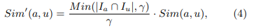
Significance weight computation:
Pearson Correlation Coefficient: As we discussed earlier PCC is one of the often used algorithm for collaborative filtering.
In short we do similarity computation for both item and user, where we define the similarity between two users for user based and similarly for the item based we see the similarity between two items.
Although being more affective and having better performance, we get to see that PCC still has some drawbacks. What happens is that when we find the similarities of a user who has rated a few items similarly but in actual they may not have the corresponding performance , hence sometimes we see overestimation happening.
For the above flaw in the Algorithm a modified similarity equation was brought out .

Slide 5
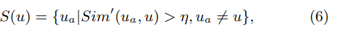
Similar Neighbour selection:
To start with predicting the missing values in the data. We first looked upon the similar neighbour selection concept.
Selecting the right neighbour with respect to the current user will give us a better prediction for missing data.
Going Back to what we did previously(in our tutorial) we implemented the Top-N neighbour selection algorithm.
Now to overcome the flaw in this algorithm by not just looking over the top K most similar user/items we introduce item similarity threshold (ITA and THETA) .
Here we basically validate that the similarity between the neighbours and the current user an the item is above the threshold.
Also in the mean time Selecting the value of ITA and THETA is very significant as a large value will cause shortage of similar item and user and again a smaller value will do the opposite.

Slide 6
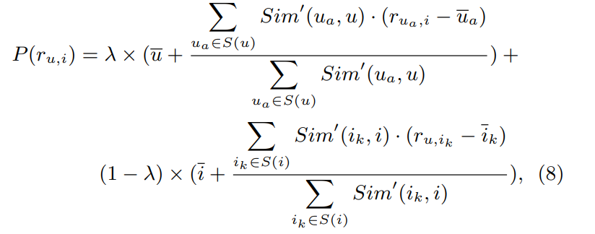
Drawbacks of Top N Neighbours:
As discussed in the previous slide the drawback of algorithms like TOP-N algorithm where we pick a certain value for K neighbours .
While doing this sometimes we may just take more than what is required and sometimes underestimate the k valve. Which can cause a serious flaw in our prediction.
While using the user and item based collaborative filtering we here try to use the item based and user based separately for better approach.
We Combine both in such a way for better result .
Now coming back to the Flaw in Top-N algorithm to overcome this drawback we basically make use of eqn 6 and 7 i.e., the similar user and similar item.
For our best case where we have both similar item and user we use both the information.

Slide 7
How does the EMDP tackle Missing values efficiently:
Similar neighbour selection.
More precisely making use of all the given information of what we have .
Providing for exclusive conditions to predict missing values.
Example: even If we don’t have a similar item we make use of the information of similar user to find the missing data.
Hence very effective and efficient :

Slide 8
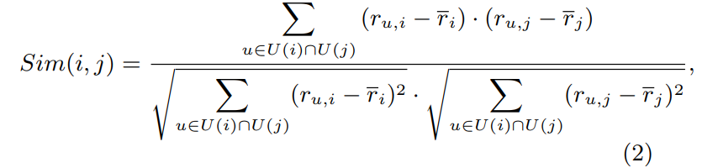
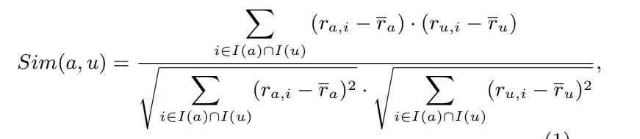
Implementation of Effective Missing Data Prediction for Collaborative Filtering step by step:
Basically we start with calculating the PCC :
For both users and items :

Slide 9
Now we simply find the significance weighting of both the user and item:

Slide 10
Here of we start the main frame work of the Algorithm provided.
First as discussed earlier we bring forward the similar neighbour selection (a better improvisation to algorithms like Top-K neighbour selection)
Major changes being we include a threshold to the weighted similarity for both user and item giving us similar item and users. Where significance weighting has to be greater than those threshold (ITA and THETA).

Slide 11
Prediction of missing values:
Here basically as discussed in the earlier slides we make complete use of all the data provided .
In short again four conditions for prediction:
1: There are both similar users and similar items: Refer(eqn 8 below)
2:There are similar items but no similar users. Refer to (eqn 10 slide 12 )
3:There are similar users but no similar items: Refer to (eqn 9 slide 12)
4: No similar items and users the prediction is will be zero.

Slide 12
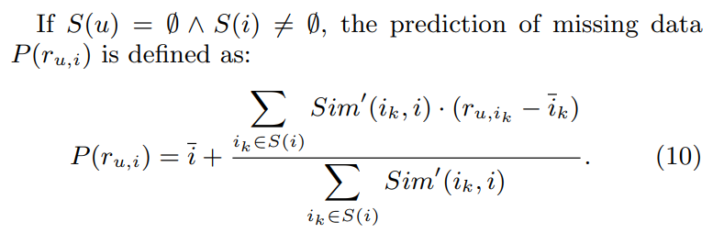
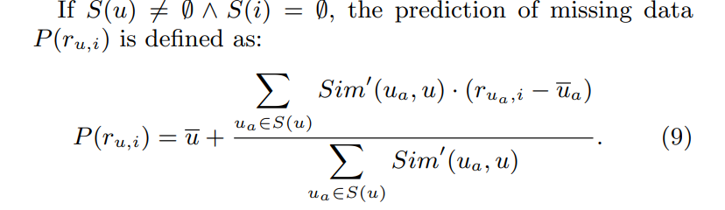
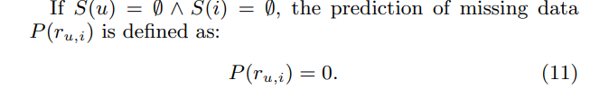
In case where we are only limited to one of similar user or item then we make user of the following approach . This makes us use each and every information possible to obtain the best prediction.
And of course the worst case scenario we just make it zero where we do not have both similar user and item.

